Slide 1
Visualizing Collections Of Internet Archives
John Berlin, Joel Rodrizuez, Slobodan Milanko

Slide 2



Motivation
Current solutions are limiting; small focus
Archivers are unable to visually experience
their collections
Lack of URI evolution
Lack of comparison
User driven, clutter free, design

Slide 3
Dataset Description

Slide 4
Abstract Tasks

Slide 5

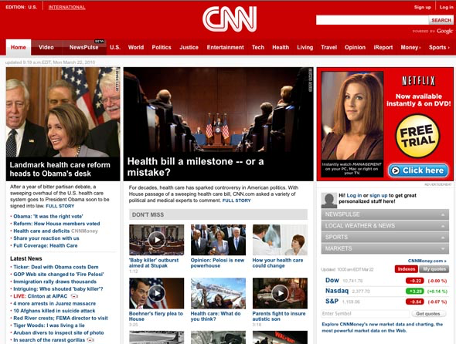

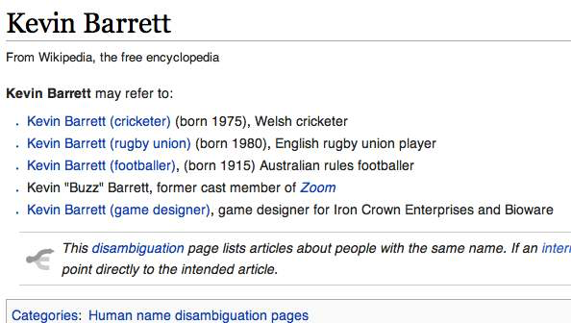
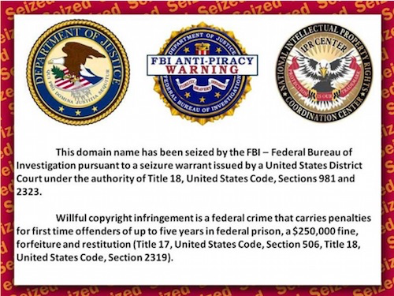
Potential Design

Slide 6
User Driven Control
FILTER
Selection
Group
Criteria
Filter and drill
down by desired
precision
CATEGORY
Date
Tags
URI-M

Slide 7
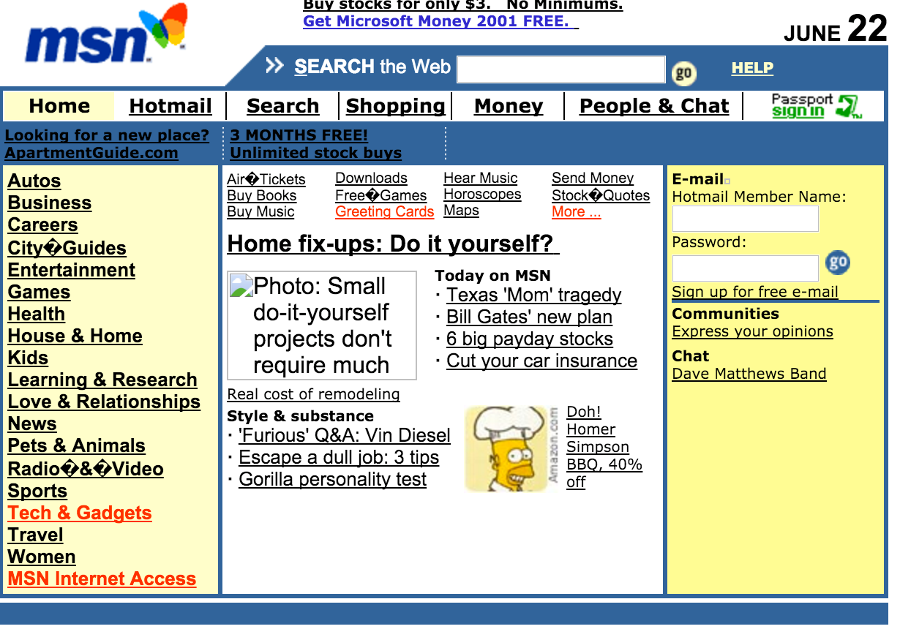


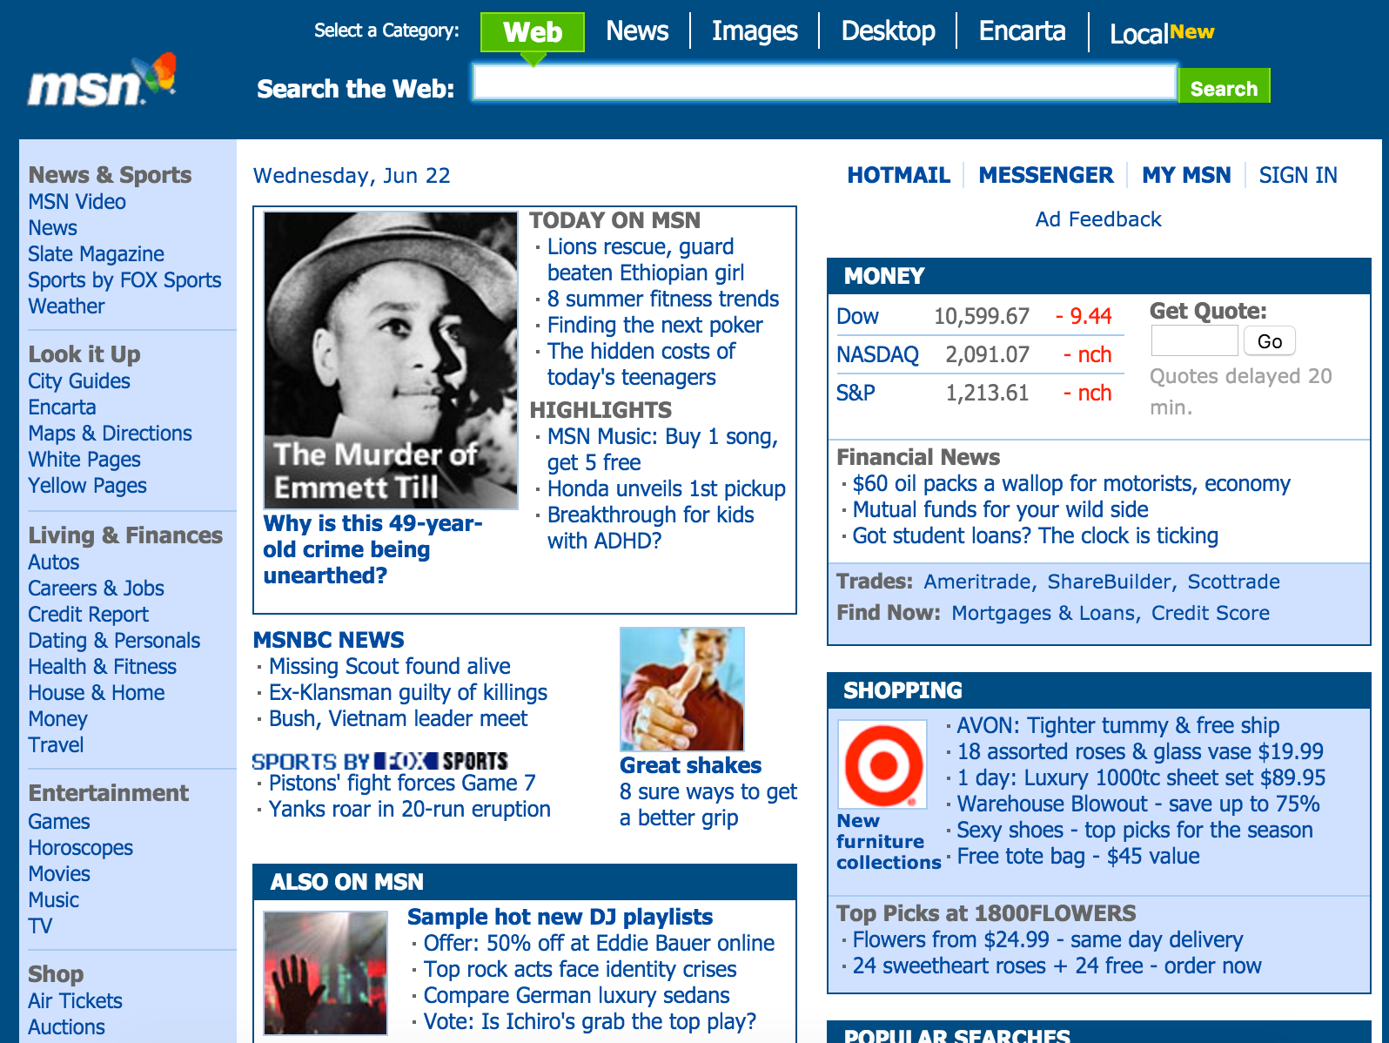
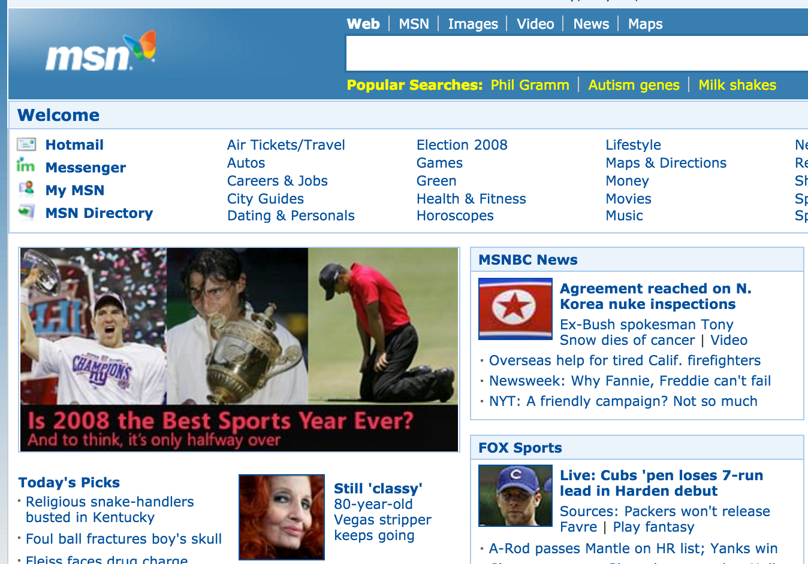
Detail
www.msn.com/news/june
June 22, 2001
BACK
www.msn.com/news/june
June 22, 2005
www.msn.com/news/may
May 22, 2005

Slide 8
Needed Tools
WARCreate
PhantomJS

Slide 9
Group Roles

Slide 10
Estimation

